Slide 1
DIMENSIONALITY REDUCTION
FOR FACE RECOGNITION

Slide 2
PROJECT OBJECTIVE
Face recognition has become a very common system in the modern world
The data processed for image recognition is very high.
Through Principal Component Analysis we can reduce the dimensionality while retaining the utmost detailing
Compression is achieved while still maintaining the significant patterns and trends
This is achieved with the mathematical concepts of Eigen decomposition and Singular Value Decomposition(SVD).
We analyse this concepts while trying to incorporate the same in different applications.

Slide 3
DATA PROCESSING
DATA FOR FACE RECOGNITION

Slide 4
DATA SET WE USED
ORL DATASET
OUR OWN DATASET
The ORL dataset, is a collection of face images used for research in facial recognition.
It contains 400 images of 40 different people.
For each person, there are 10 images capturing variations in lighting, facial expressions (smiling, frowning, with/without glasses) and slight head tilts.
We have also added our own faces into the dataset.
Even here we have different faces of same person by variations in lighting, facial expression and head tilts.

Slide 5
FACE RECOGNITION CLASS
This is our driver class, designed to dynamically call and manage other necessary classes throughout the execution process. These classes are accessed and utilized at appropriate times based on the requirements of the application. This ensures efficient and organized workflow management within the program.
Some of the classes it call are
Dataset
Image_to_matrix
PCA

Slide 6
DATASET CLASS
1. The class initializes by setting up the directory path for the dataset and creating empty lists and dictionaries to store image paths, labels, and counts for both training and testing datasets.
2. It iterates through each person's directory within the dataset.
3. For each directory, it verifies if the number of images meets the required threshold for training.
4. It then splits the images into training and testing sets.
5. While doing so, it labels the images, associating each image with a specific person's identifier, and maintains counts of images per person for both training and testing datasets.
6. The first image of each person is used to populate the target labels.

Slide 7
IMAGE_TO_MATRIX CLASS
1. The class initializes by taking a list of image file names and the desired width and height for each image.
2. It calculates the total size of each image by multiplying the width and height.
3. The `get_matrix` method converts the images into a matrix where each column represents a flattened image.
4. It creates an empty matrix with dimensions corresponding to the total number of pixels in an image and the number of images.
5. It iterates through each image file name:
- Reads the image in grayscale.
- Resizes the image to the specified width and height.
- Converts the image into a matrix and flattens it into a column vector.
- Stores this column vector in the appropriate column of the matrix.
6. Finally, it returns the matrix containing all the images.

Slide 8

02
PRINCIPAL COMPONENT ANALYSIS
How PCA utilizes the Eigen Speciality

Slide 9
EIGEN VECTORS
SPECIALITY OF EIGEN VECTORS

Slide 10
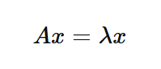
WHY EIGEN VECTORS

Slide 11
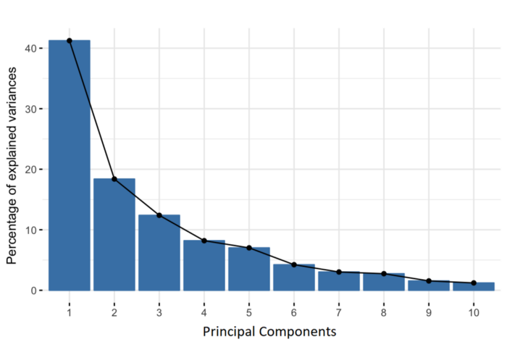
EIGEN VECTORS AND PCA

Slide 12
PCA CLASS
1. Initialization
- The `__init__` method initializes the class with the provided images, labels (`y`), target names, number of elements per class, and quality percentage for dimensionality reduction.
- It computes the mean face and centers the images by subtracting the mean face from each image.
2. **Dimensionality Reduction**:
- The `reduce_dim` method performs Singular Value Decomposition (SVD) on the images to obtain the principal components.
- It uses the `give_p` method to determine the number of principal components (`p`) needed to retain the specified quality percentage of the data variance.
- The new bases (eigenvectors) are selected, and the images are projected onto these new bases to get the reduced coordinates.

Slide 13
PCA CLASS
3. Reconstruction:
- The `original_data` method reconstructs the original data from the reduced coordinates by adding the mean face back to the projected data. This code defines a `pca_class` that performs Principal Component Analysis (PCA) to reduce the dimensionality of image data and facilitate face recognition. Here's a detailed explanation:
4. Visualization:
- The `show_eigen_face` method visualizes an eigenface by scaling it to a specified pixel intensity range and displaying it using OpenCV.
5. New Coordinates Calculation:
- The `new_cord` method calculates the new PCA coordinates for a given image file.
- The `new_cord_for_image` method calculates the new PCA coordinates for an image matrix.

Slide 14
PCA CLASS
6. Face Recognition:
- The `recognize_face` method identifies the closest match for a given PCA-transformed image by calculating the Euclidean distance between the new coordinates and the mean coordinates of each class.
- If the distance is below a threshold, it returns the name of the recognized person; otherwise, it returns 'Unknown'.
This class leverages PCA for efficient image representation and face recognition, ensuring the data is compressed and informative for the supervised learning algorithm.

Slide 15
RESULTS :
INPUT DATA -

Slide 16
EIGEN FACES
INPUT DATA
TO
OUTPUT DATA

Slide 17
OUTPUT
FOUND MATCH

Slide 18
FUTURE SCOPE
Security Areas
Self Driving Cars

Slide 19
CONTRIBUTION
Santhosh M
Implementation of PCA
Nilavarasan
Implement application using Machine learning
Gowtham
Data production
Yashwanth
Implement application using Machine learning

Slide 20
PROJECT REFERENCES
PRINCIPAL COMPONENT ANALYSIS IN IMAGE PROCESSING by M. Mudrov´, A. Proch´azka mudrova.pdf (vscht.cz)
An improved face recognition technique based on modular PCA approach by Rajkiran Gottumukkal - An improved face recognition technique based on modular PCA approach - ScienceDirect
Introduction-to-Machine-Learning/Face Recognition Using PCA at master · codeheroku/Introduction-to-Machine-Learning (github.com)

Slide 21
THANK YOU

